Slide 1
VC Dimension

Slide 2
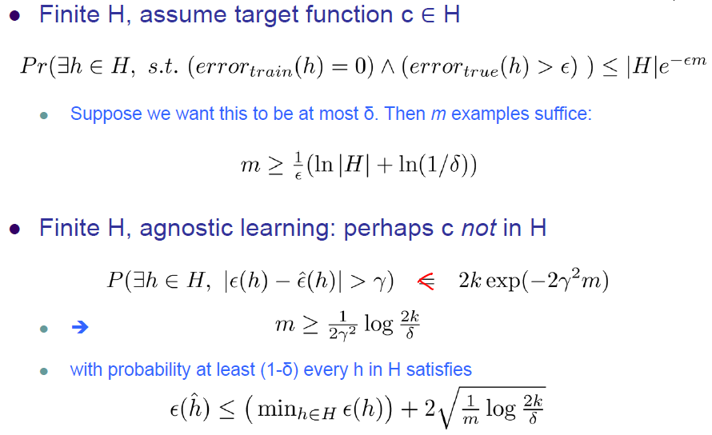
PAC and Agnostic Learning

Slide 3
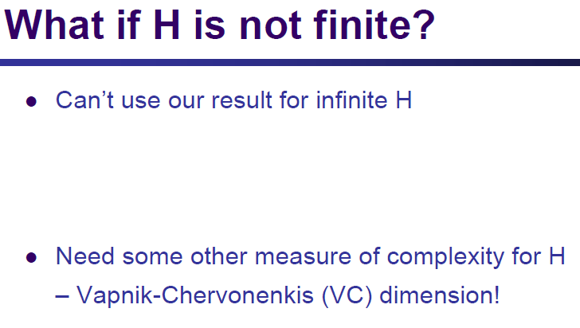

Slide 4
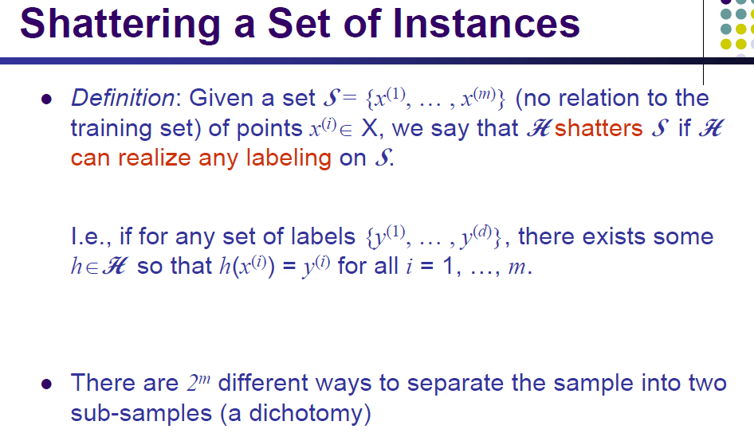

Slide 5
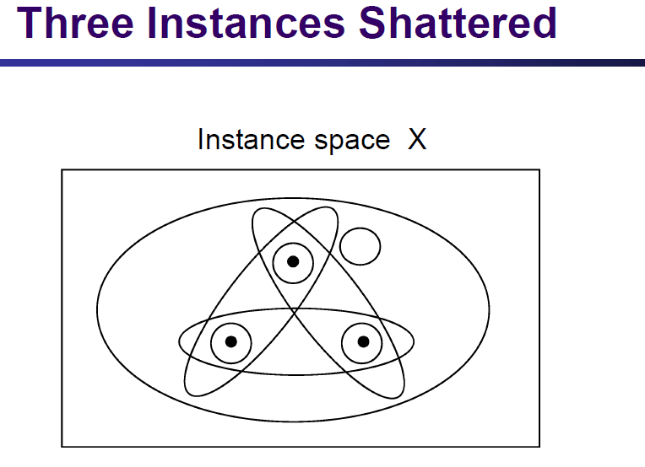

Slide 6
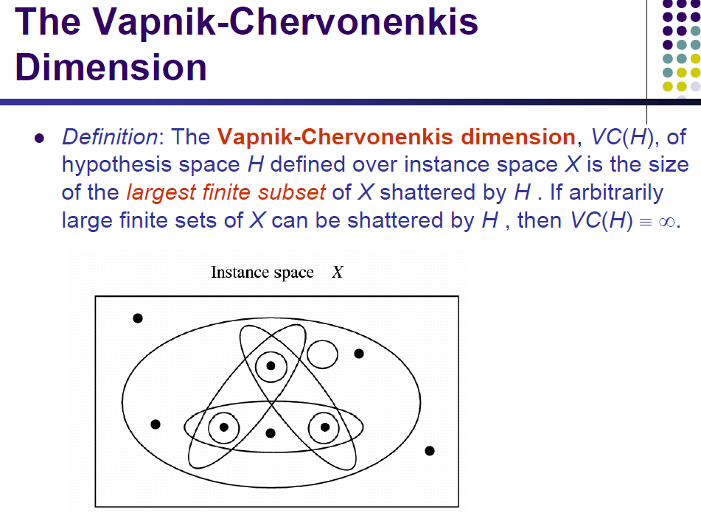

Slide 7
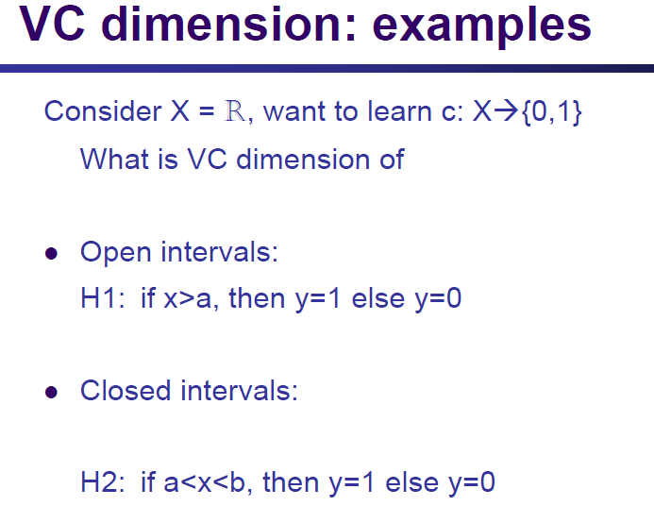

Slide 8
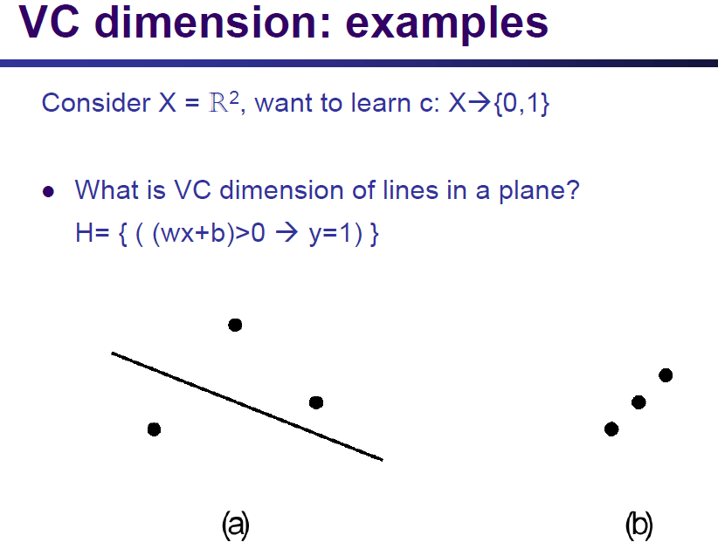

Slide 9
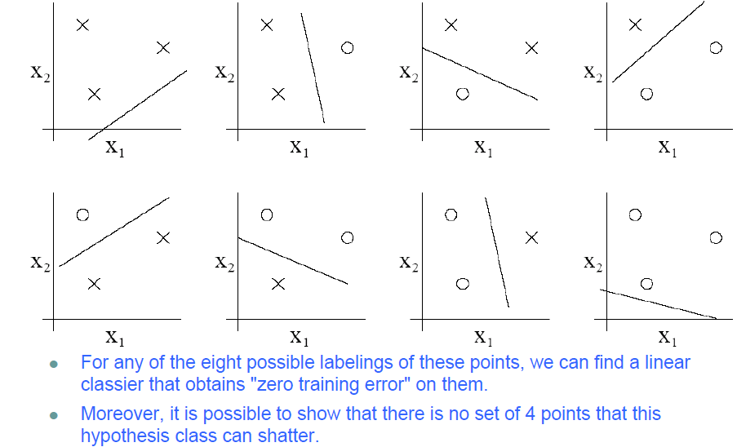

Slide 10
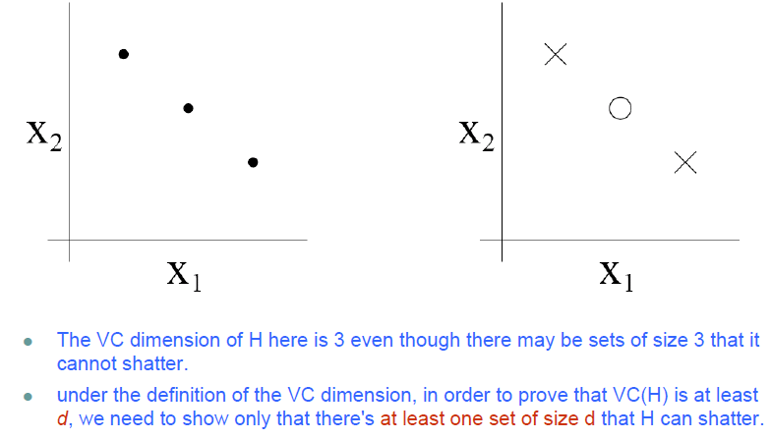

Slide 11
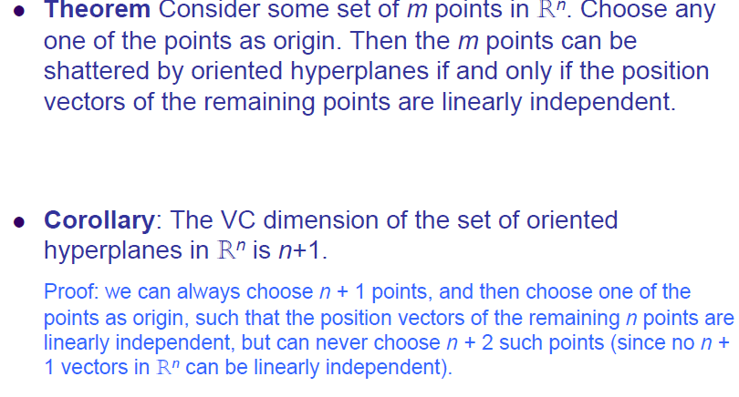

Slide 12
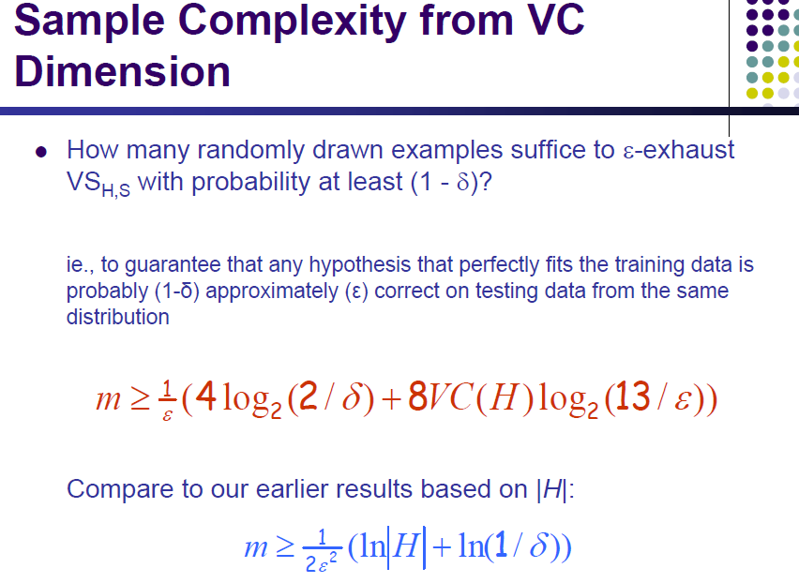

Slide 13

The Vapnik-Chervonenkis dimension
The Vapnik-Chervonenkis dimension of H is d if there exists such an S, |S|=d which it can shatter, but it cannot shatter any S for |S|=d+1 (If it can shatter any finite S then VCD=∞.)
Theorem: Let C be a concept class,a and H a representation set for which VCD(H)=d. Let L be a learning algorithm that learns c∈C by getting a set S of training samples with |S|=m, and it outputs a hypothesis h∈H which is consistent with S. The learning of C over H is PAC learning if
(where c₀ is a proper constant)
Remark: In contrary to the finite case, the bound obtained here is tight (that is, m samples are not only sufficient, but in certain cases they are necessary as well).

Slide 14
The Vapnik-Chervonenkis dimension
Let’s compare the bounds obtained for the finite and infinite cases:
Finite case:
Infinite case:
The two formulas look quite similar, but the role of |H| is taken by the Vapnik-Chervonenkis dimension in the infinite case
Both formulas increase relatively slowly as a function of ε and δ, so in this sense these are not bad boundaries…

Slide 15
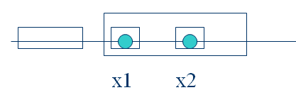
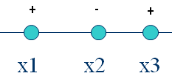
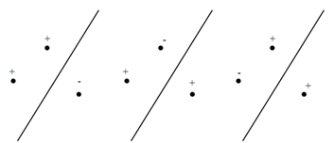
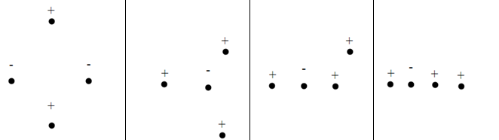
Examples of VC-dimension
Finite intervals over the line: VCD=2
VCD≥2, as these two points can be shattered: (=separated for all label configurations)
VCD<3, as no 3 points can be shattered:
Separating the two classes by lines on the plane: VCD=3 (in d-dimensional space: VCD=d+1)
VCD ≥3, as these 3 points can be shattered: (all labeling configurations should be tried!)
VCD<4, as no 4 points can be shattered: (all point arrangements should be tried!)

Slide 16
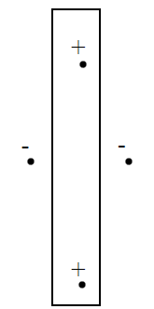
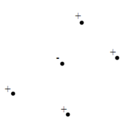
Examples of VC-dimension
Axis-aligned rectangles on the plane: VCD=4
VCD≥4, as these 4 points can be shattered:
VCD<5, as no 5 points can be shattered:
Convex poligons on the plane: VCD=2d+1 (d is the number of vertices) (the book proofs only one of the directions)
Conjunctions of literals over {0,1}^{n} : VCD=n (See Mitchell’s book, only one direction is proved)

Slide 17
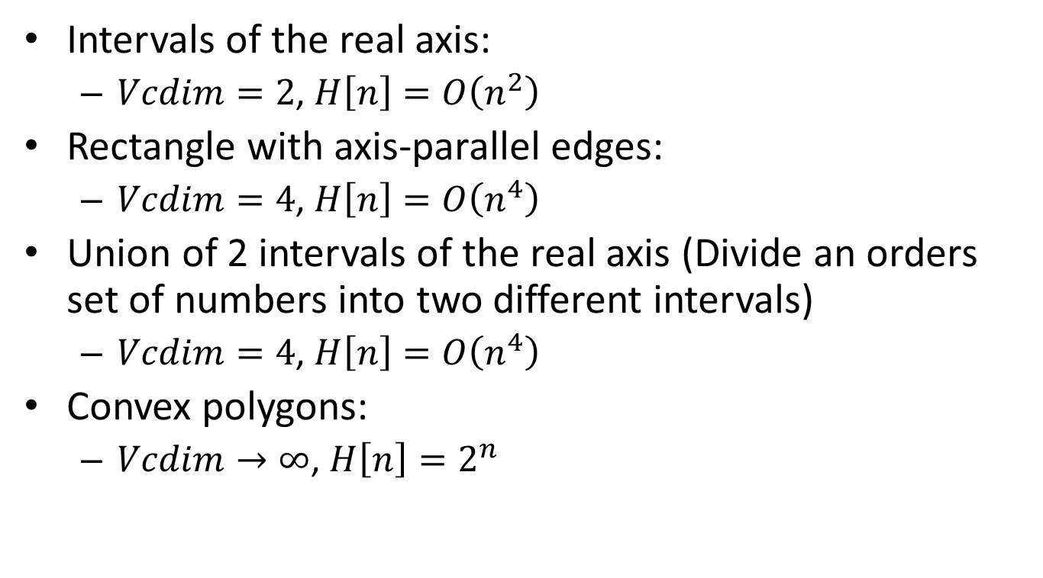
Examples

Slide 18
Example
Consider a database consisting of the salary and age for a random sample of the adult population in the United States.
We are interested in using the database to answer the question:
What fraction of the adult population in the US has:
- age between 35 and 45
- salary between 50,000$ and 70,000$ ?
70,000
50,000
35
45

Slide 19
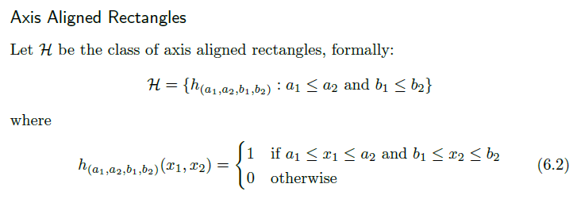

Slide 20


Slide 21
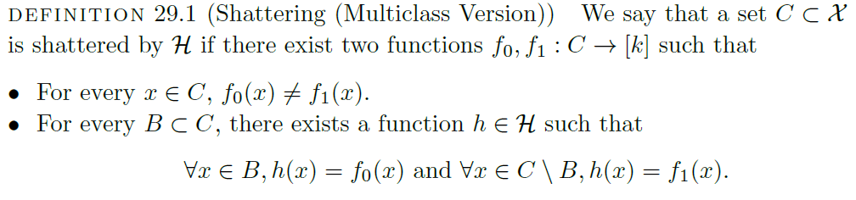

Slide 22
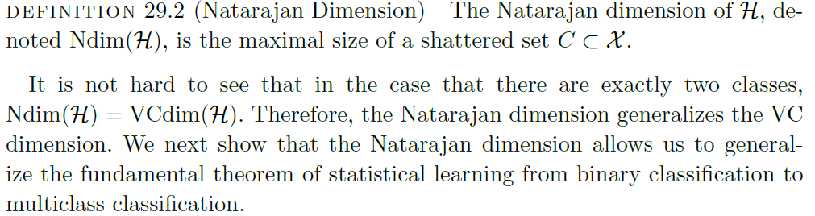

Slide 23
Thanks

